Slide 1
EXCEPTION & TYPES

Slide 2
INTRODUCTION TO EXCEPTION HANDLING
Problem that arises during the execution of A program. It can occur for various reasons say-
A user has entered an invalid data
File not found
A network connection has been lost in the middle of communications
The JVM has run out of A memory

Slide 3
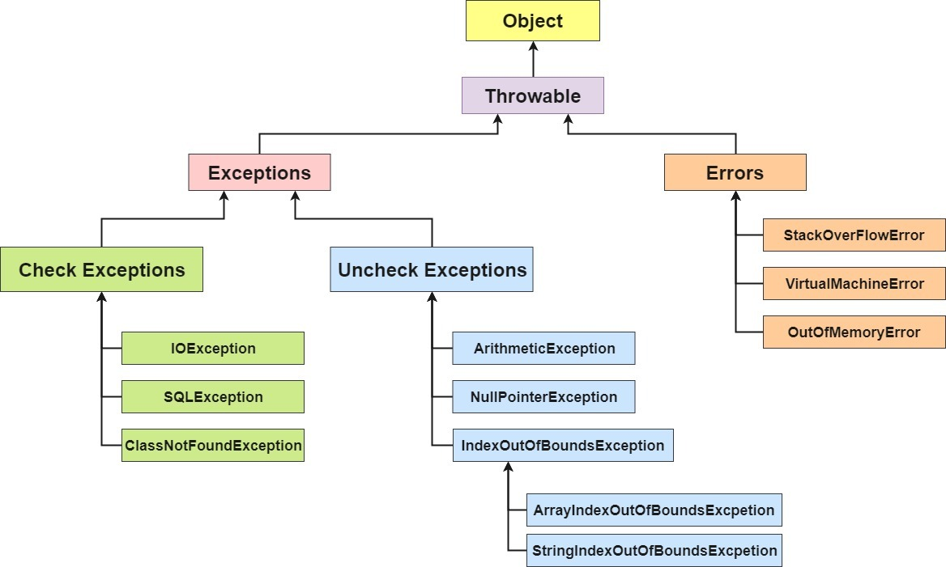
TYPES OF EXCEPTION

Slide 4
CHECKED EXCEPTION(COMPILE TIME EXCEPTIONS)
Occurs at compile time
If some code within a method throws a checked exception, then the method must either handle the exception or it must specify the exception using throws keyword.
UNCHECKED EXCEPTION(RUNTIME EXCEPTIONS)
Occurs at the time of execution.
It is up to the programmers to specify or catch the exceptions.

Slide 5
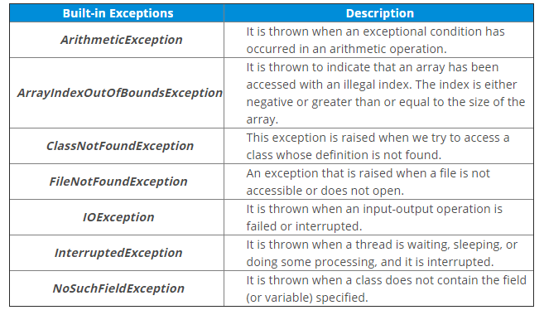
BUILT IN EXCEPTION

Slide 6
USER-DEFINED EXCEPTIONS The built-in exceptions in Java are not able to describe a certain situation. In such cases, a user can also create exceptions which are called ‘User-Defined Exceptions’.
A user-defined exception must extend Exception class.
The exception is thrown using throw keyword.

Slide 7
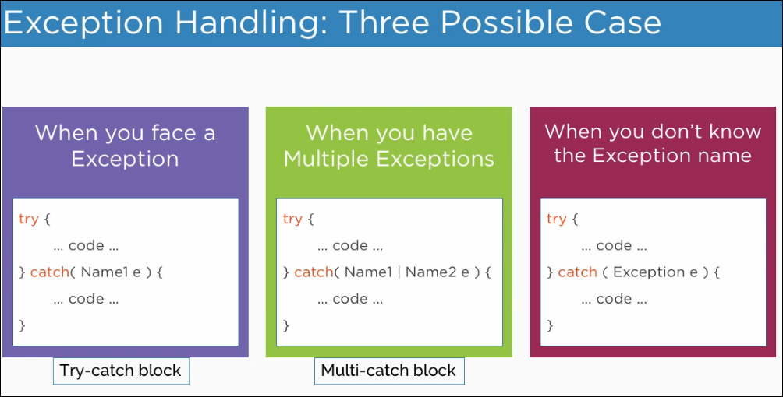

Slide 8
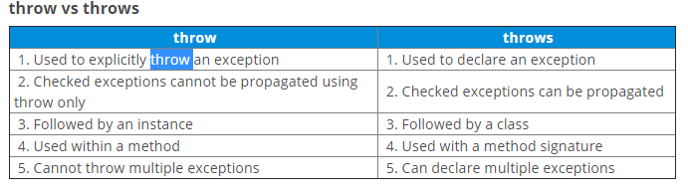
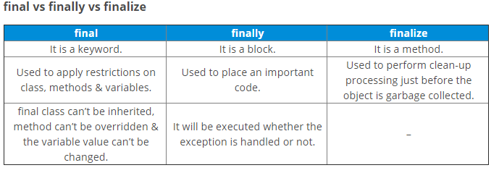

Slide 9
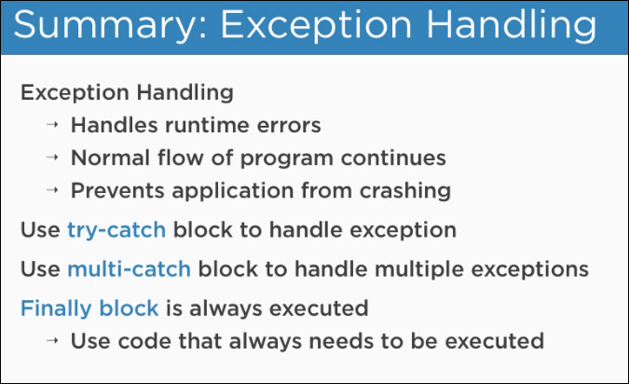

Slide 10
EXAMPLES

